Slide 1

P5-NPOI
Initial Testing Results
Bradley Kingsley
Dustin Haines
Trung Son Nguyen

Slide 2
Design Requirements Summary
Create an Updated Vacuum Interface:
  Lightweight (CR #1)
  Adjustable Components (CR #4)
  Small Deformations – Optical Standard (CR #5)
  Ability for interior Access in Vacuum State (CR #7)
  NEW – Prototype Allows Light in & Out Unclipped (CR #8)
CR's 2,3, & 6:
  Unable to complete due to deliverable modification in Jan. 2023
  CR/ER #2 – Disassembly in less than 1 hour
  CR/Er #3 – Seals to Vacuum and ATM
  CR/ER #6 – Drift Less than 0.001" Per Month
Haines 1

Slide 3
Top Level Testing Summary
Experiment/Test | Relevant Design Requirement
Front Seal Plate Weight | CR/ER 1
Rear Seal Plate Weight | CR/ER 1
Front Seal Plate Deflection | CR/ER 5
Rear Seal Plate Deflection | CR/ER 5
Snoot Plate Adjustment | CR/ER 4
Snoot x/y Adjustment (combined) | CR/ER 4
Rear Seal Plate Sight Port Count | CR/ER 7
Allow Laser in & out of Scaled System | ER 8 (NEW, allow light into and out of the system without clipping. Allow full adjustment of parts)
Nguyen 2

Slide 4
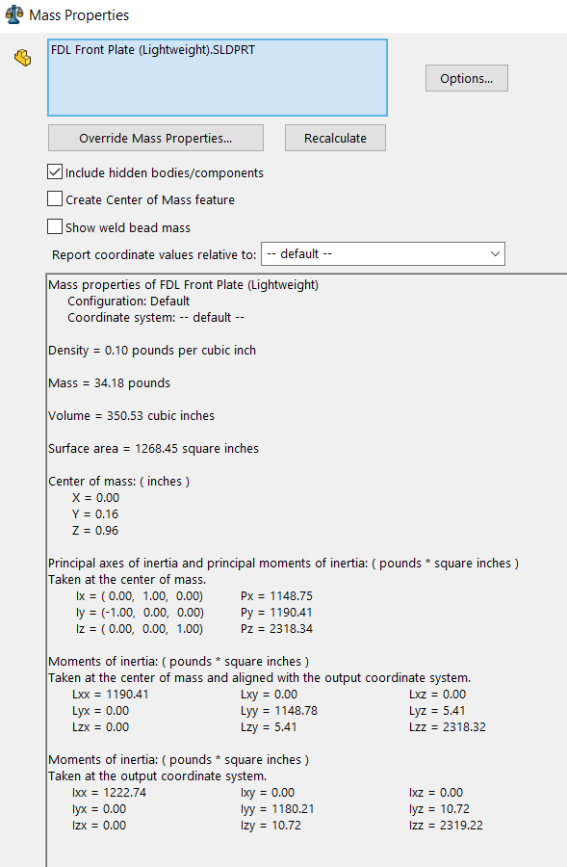
Test #1 & #2 – Seal Plate Weight
Verify Weight of 3D Model in SolidWorks
Use Material Spec. Sheet given by material supplier for density
Verify Weight with equation:
  Weight = Volume * Density
Weight Must be Below 35 Pounds
  Front & Rear
To-Be Completed
Haines 3

Slide 5
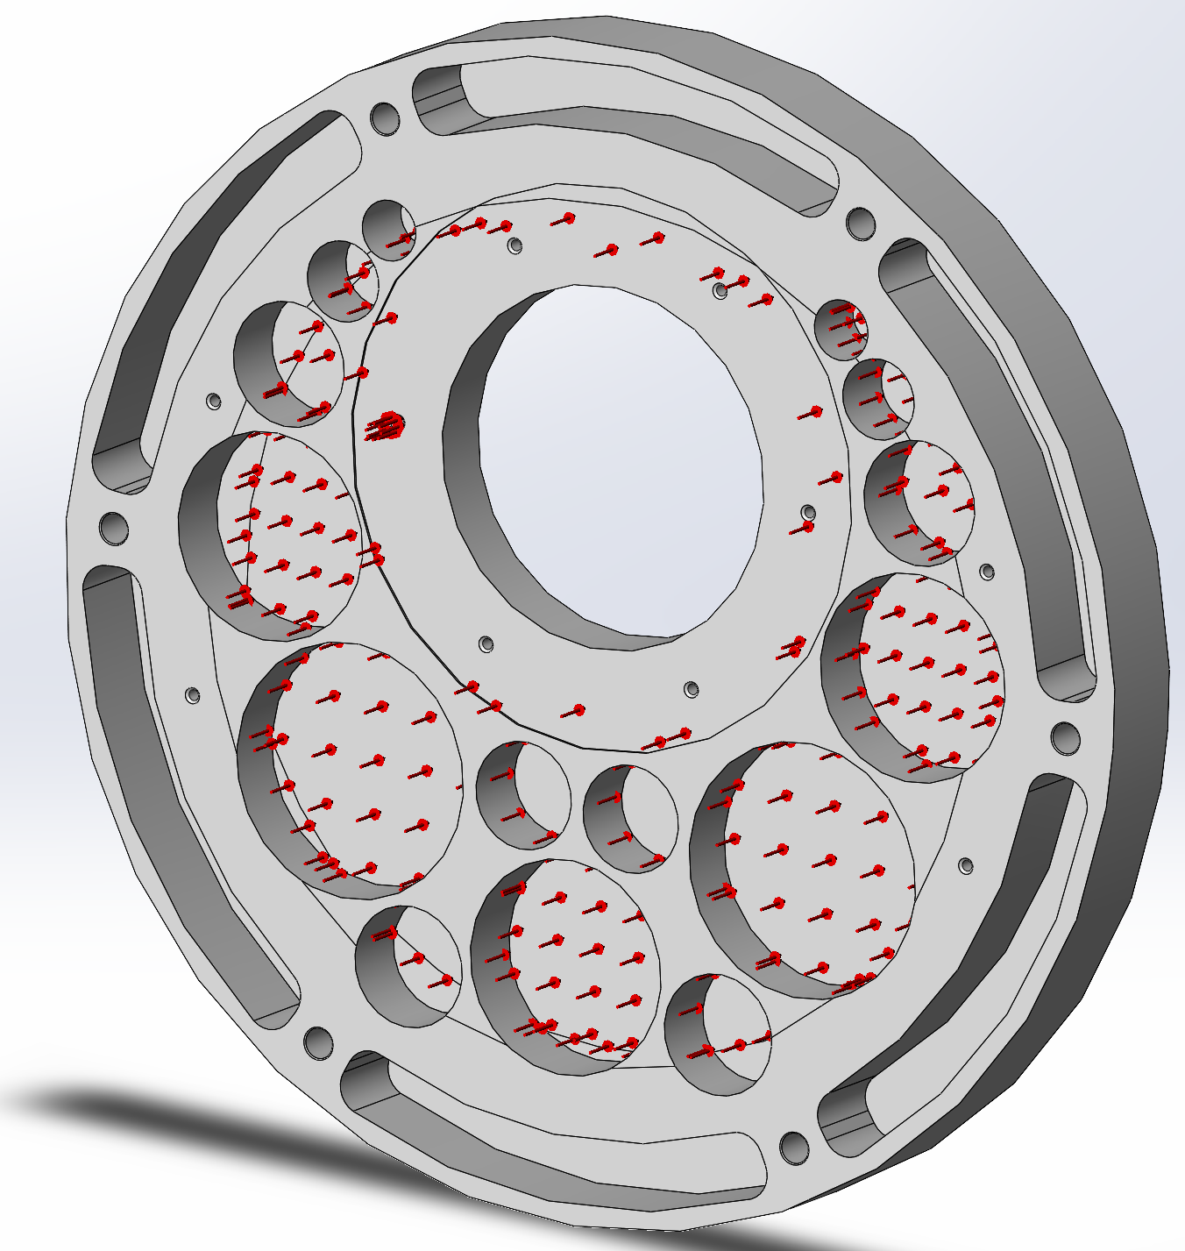
Test #3 & #4 – Seal Plate Deflection
Use of SolidWorks and ANSYS Workbench
Apply Material properties (6061-T651):
  Poisson's Ratio
  Modulus of Elasticity
  Etc.
Apply Boundary Conditions:
  Rear Holde Edge Fixed Conditions (zero deflection)
  Front 16" Diameter Circle Standard ATM Pressure (14.7 PSIA)
    Corrected for local attachments applying greater pressure on Annulus
  Verify By comparing SolidWorks & ANSYS Results for equality withing 1%
Kingsley 4

Slide 6
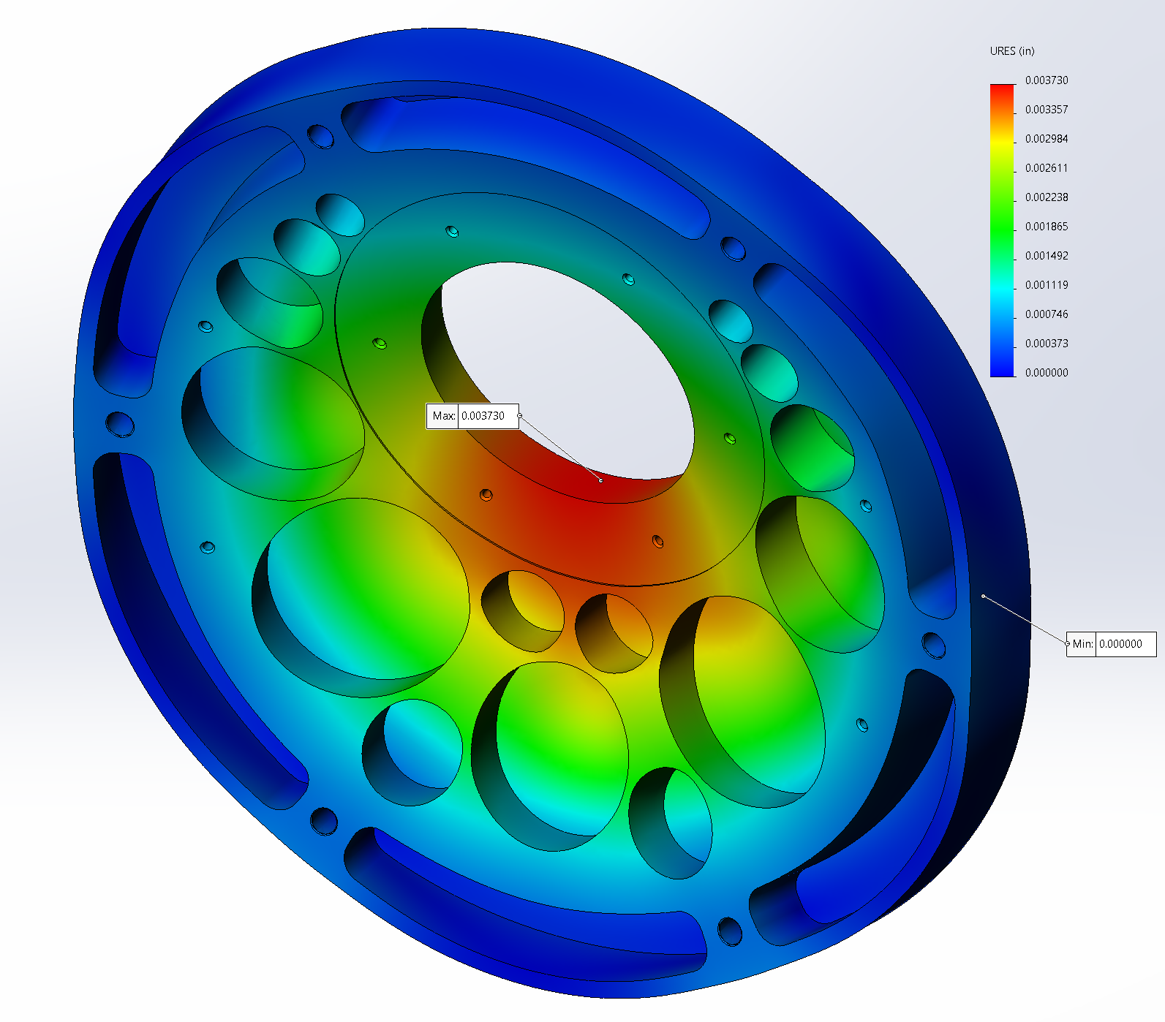
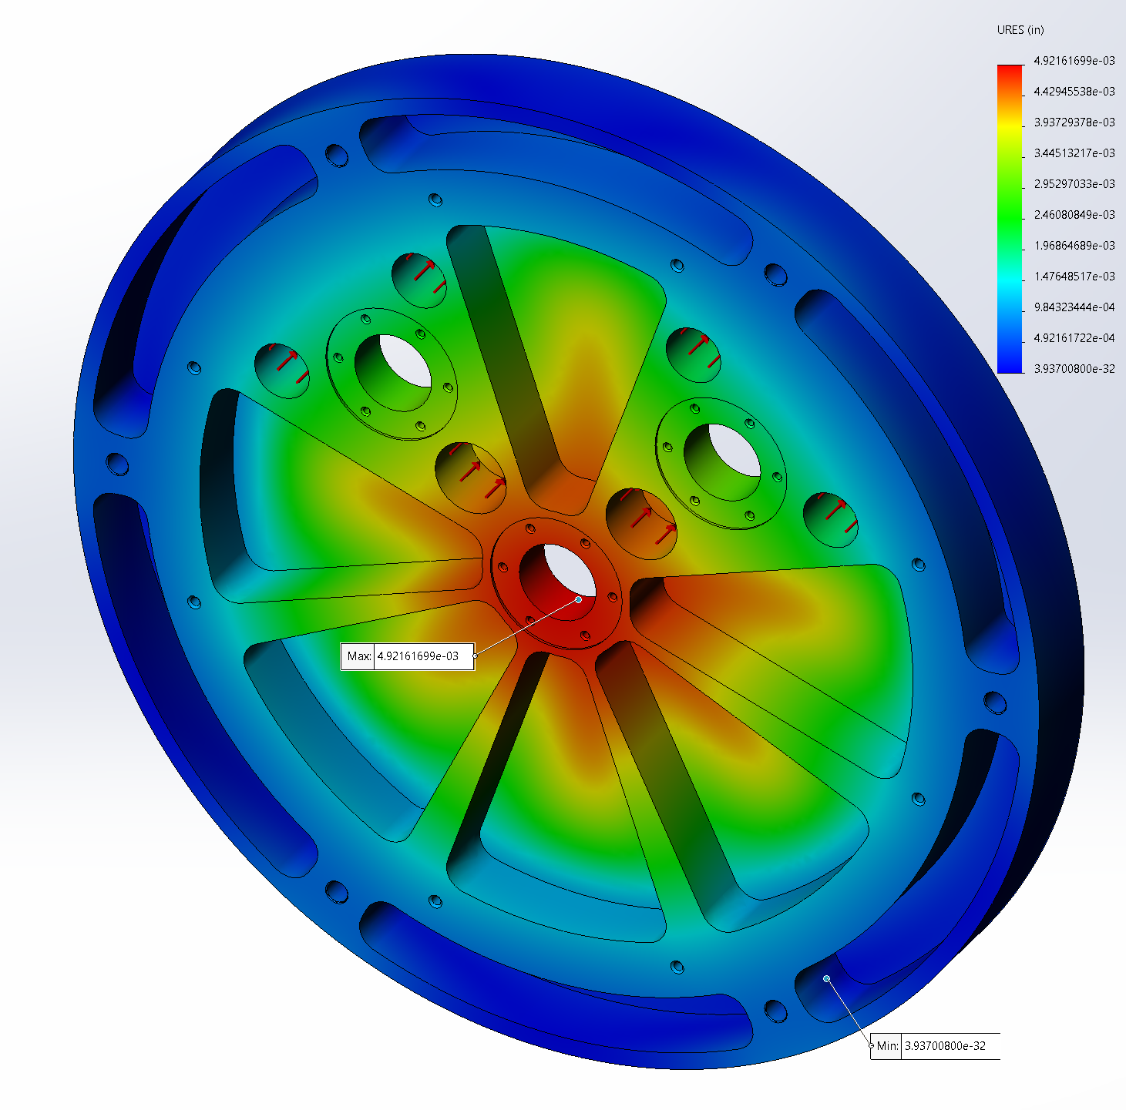
Seal Plate Deflection Results
Kingsley 5

Slide 7
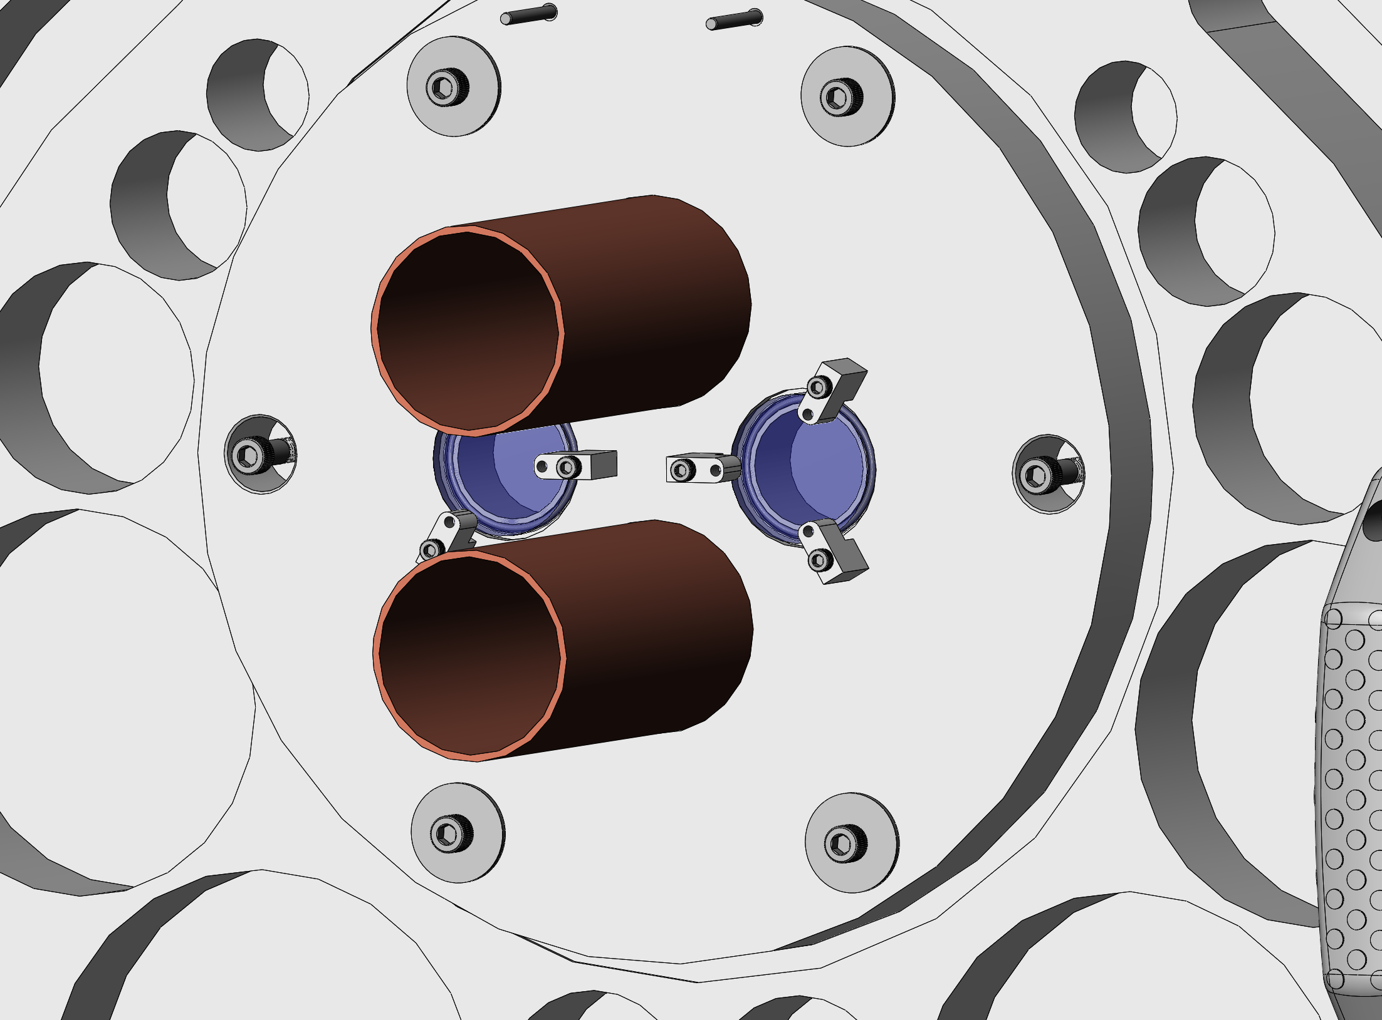

Test #5 – Snoot Plate Adjustment
Use the Front Seal Plate Assembly to Measure Deltas in X & Y
  Bring to Y-min and take reference measurement
  Bring to Y-max and take measurement
  Calculate the Delta distance as the single direction adjustability
  Repeat for the X Direction
Required Adjustment are 35% of Full Scale
  $∆_{prototype}=∆_{fullScale}∗0.35=0.175"$
  $∆_{fullScale}=0.5"$
Outcome: $∆_{prototype, found, X \& Y}$ = 0.190”
Nguyen 6

Slide 8
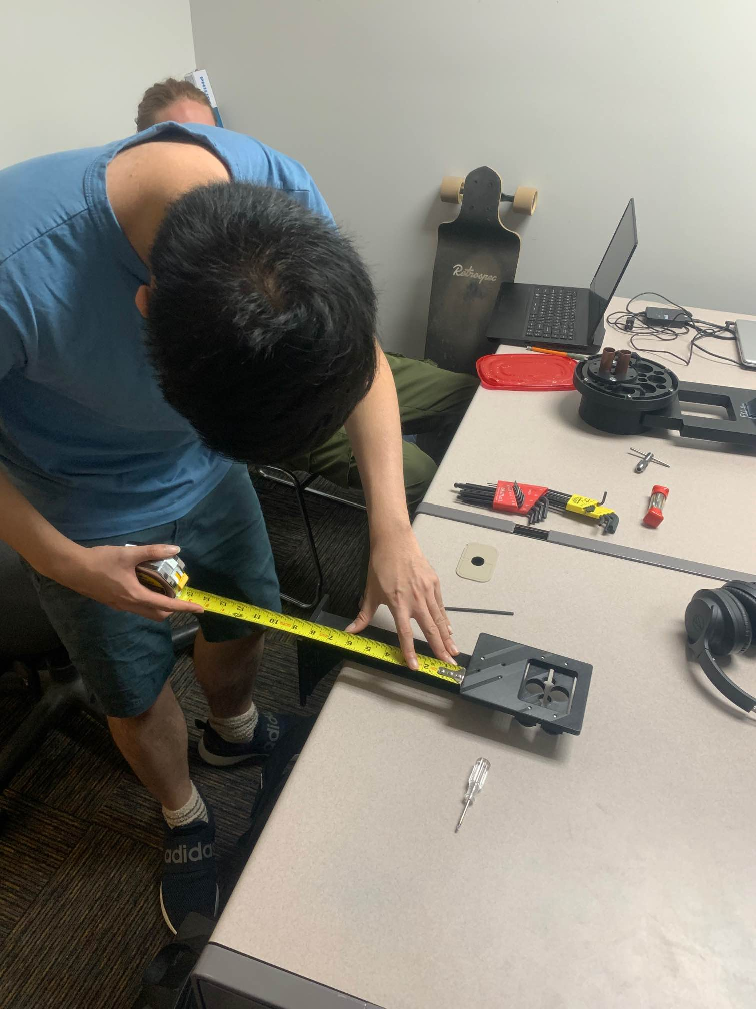
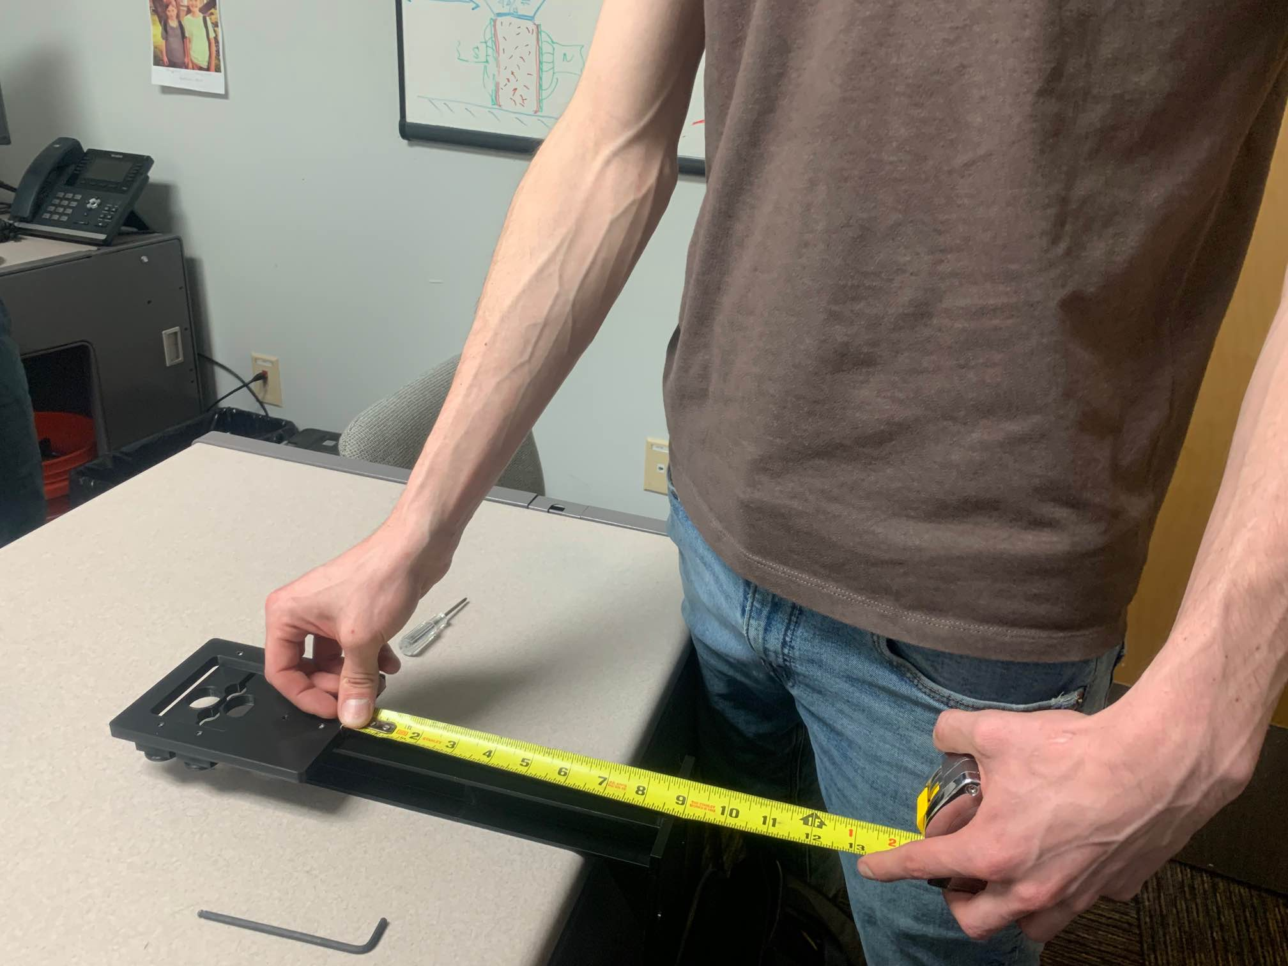
Test #6 – Snoot X/Y Adjustment
Christmas Tree and Snoot Adjustment Combined Adjustment
  Christmas Tree Vertical found:
    Max – Min = Adjustment Length
    Found Bilateral Length of adjustment = ±0.3125” = ± 5/16”
  Snoot Adjustment Plate Vertical:
    Max – Min = Adjustment Length Addition
    Found Bilateral Length of Adjustment = ± 0.125” = ± 1/8”
  Snoot Adjustment Plate Horizontal:
    Max – Min = Adjustment Length
    Found Bilateral Length of Adjustment = ± 0.125” = ±1/8”
  Full Vertical Range = 0.4375” = 7/16”
  Full Horizontal Range = 0.125” = 1/8”
  Completed
Nguyen 7

Slide 9
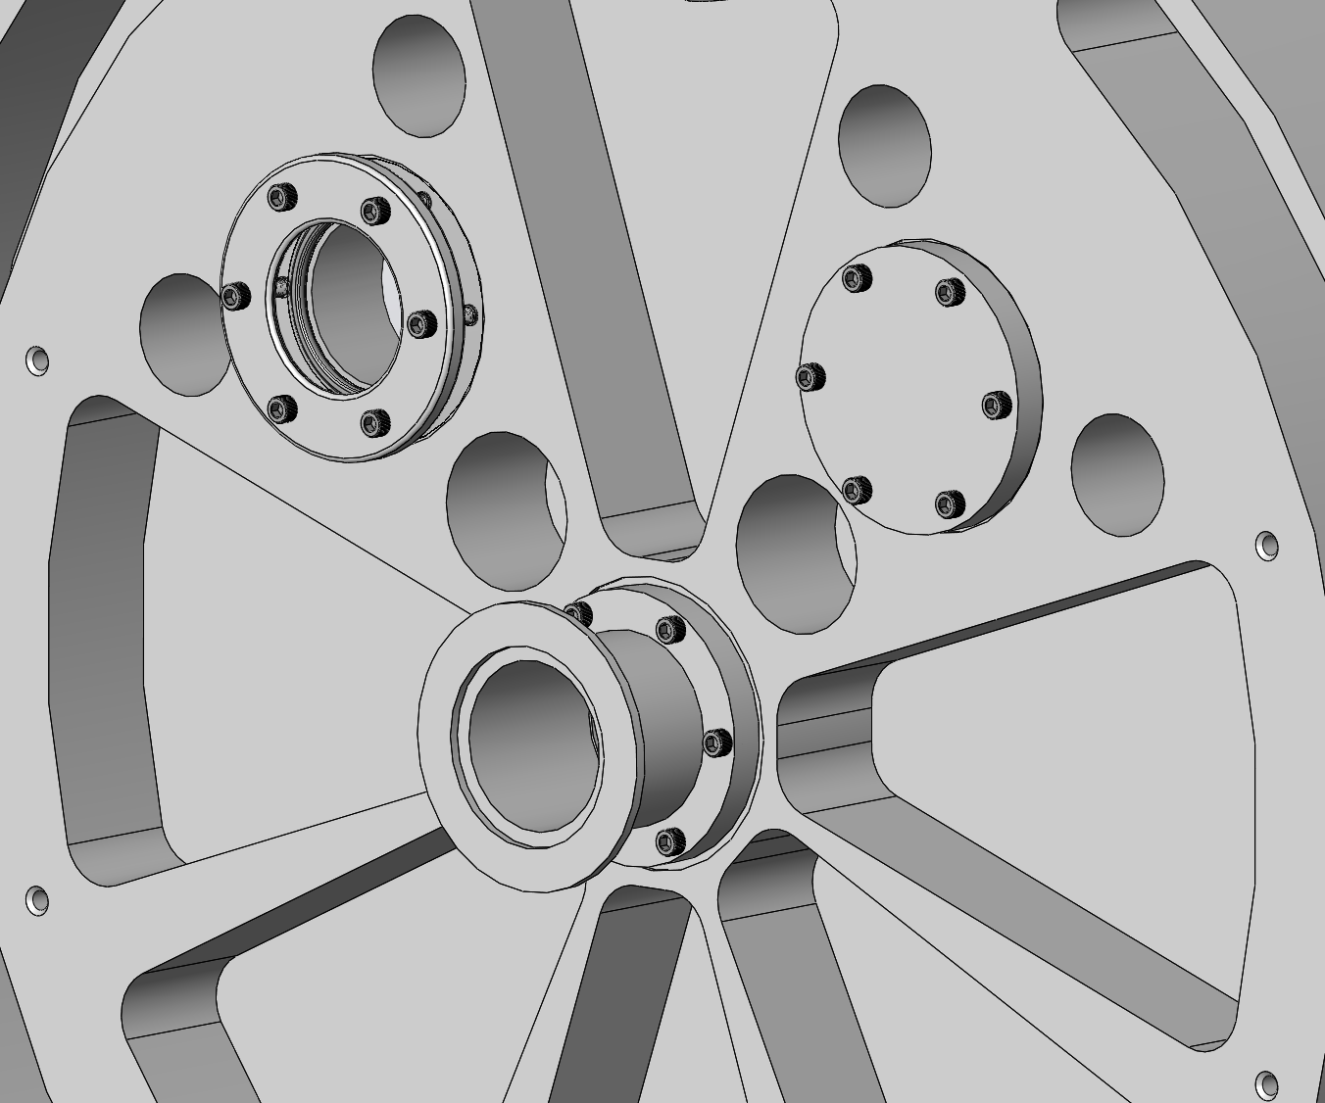
Test #7 – Rear Seal Plate Sight Port Count
How Many Poly-Carbonate Vacuum Windows Can be Attached to the Rear Seal Plate?
  Count = 0-3 Windows Can Be Attached
  All Ports Have the Same Bolt Patter and O-Ring
  Completed
Nguyen 8

Slide 10
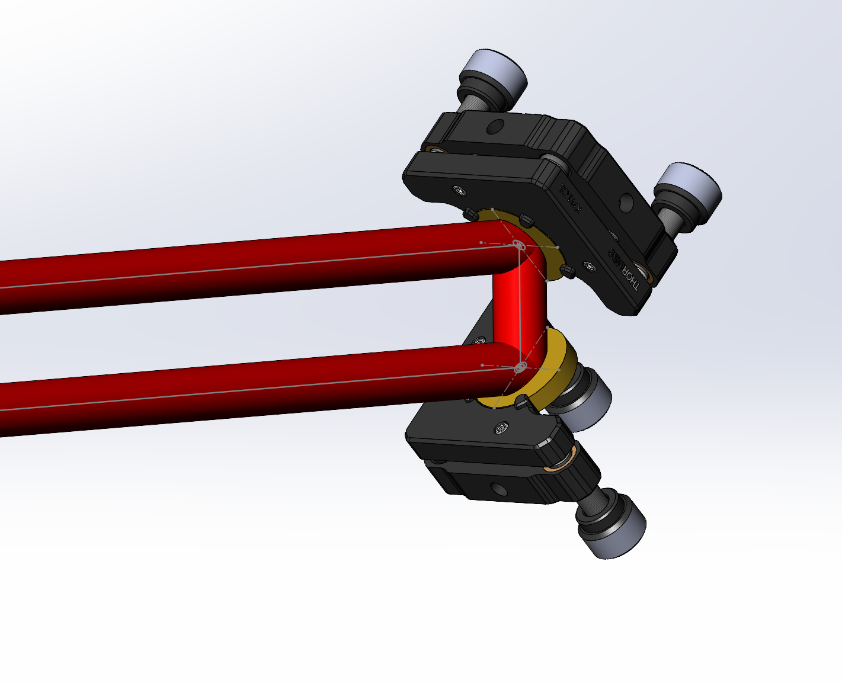
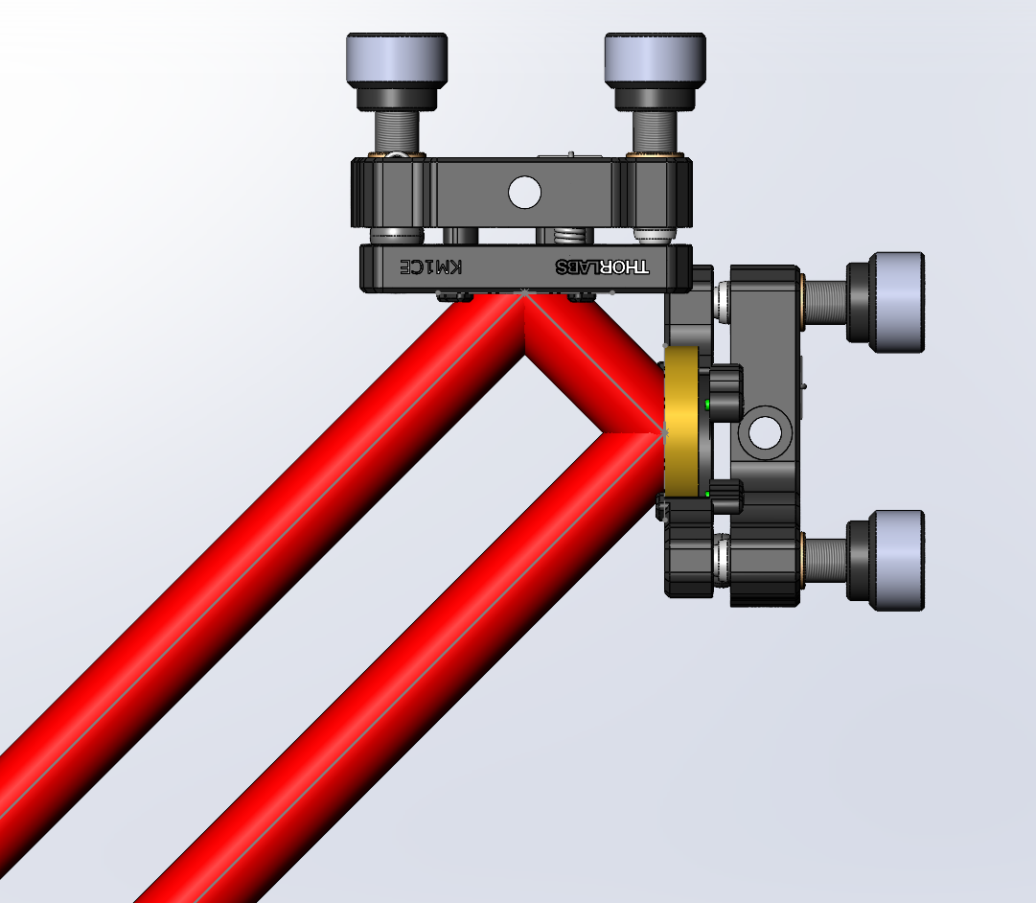
Test #8 – Laser In/Out Unclipped in Prototype
Use 2x KM1CE Thorlabs Mirror Mounts
Develop a Fixed Mount for attaching Mounts in Correct Center Location
Place the Mirror Mount Assembly on the Prototype]
Place the Laser Mount in the Prototype Assembly
Align the Mirror Mounts to Allow Light In and Out of the Prototype
Criteria: Is the beam able to enter and exit unclipped by the prototype assembly?
To-Be-Completed
Client viewed and approved the testing & result.
Kingsley 9

Slide 11
Specification Sheet
Customer Requirement | CR met (Y/N) | Client Acceptable (Y/N)
CR1 - Lightweight | TBD | TBD
CR2 – User/Technician Friendly | TBD | TBD
CR3 – Seals to Vacuum | N/A | Y
CR4 – Stable Alignment | N/A | Y
CR5 – Small Deformations | N/A | Y
CR6 – Adjustable Frame | Y | Y
CR7 – Sight Ports | Y | Y
CR8 – Allow Laser Light In/Out of the System | TBD | TBD
Haines 10

Slide 12
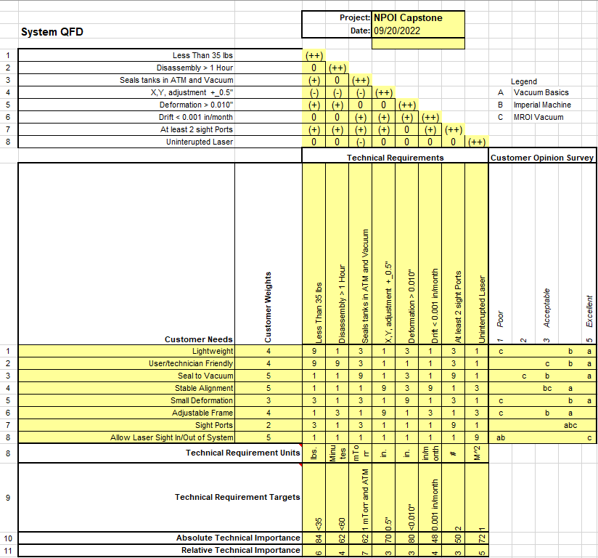
QFD
Haines 11

Slide 13
Question or Comments?

